Slide 1
3rd Year Project
By Conor Griffin & Kadrieh Mohamadzadeh

Slide 2
Development of new CI Platform 2.0

Slide 3
Introduction
The DSP bases its structure on its continuous SDM (Service Delivery Modernisation) programme which delivers a high quality service to developers, users and customers.
The SDM programme uses a main strategic system called Business Object Model Implementation – BOMi
The SDM/BOMi programme is implemented in a number of self-contained projects each of which delivers business benefits.

Slide 4
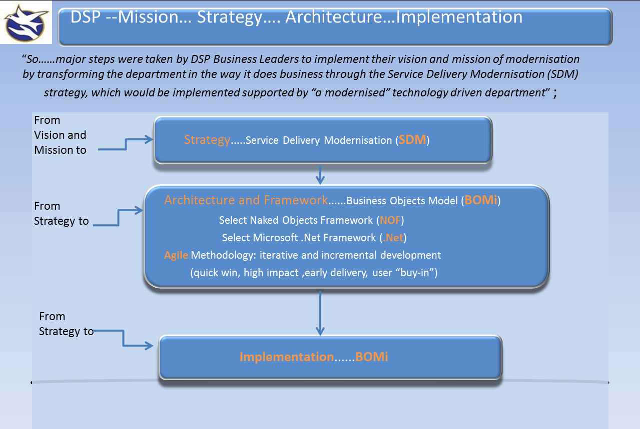
BOMi

Slide 5
Current system architecture
The architecture is hierarchical
Top branch is SDM_MAIN, this is where projects are released when they go live.
Then SDM_DEV, this is where release management takes place.
Then INTEG, where central testing occurs, projects that have been tested are raised to SDM_DEV.
There are also smaller team branches with long running projects (BOM_XXX, BOM_YYY)

Slide 6
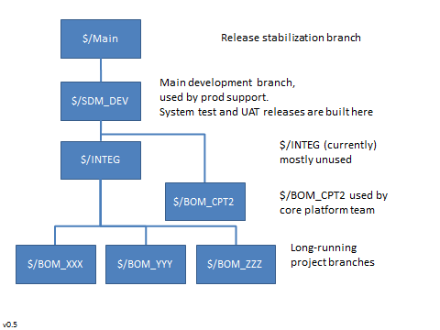
Team branches

Slide 7
CI Platform 2.0
Many of the projects being developed are constantly changing. They are ‘agile’, the project we are working on with the team is one of those projects.
The project is called CI (Continuous Integration) Platform 2.0.
The project involves changing the current company system architecture and developing a new platform for CI.

Slide 8
The SDM Platform
The original SDM project consists of .NET apps, the BOMi2 client/server application, BOMi4 web application.
Latterly though the applications are becoming much more varied, meaning that new versions are released more or less often than once a month.
All code is re-built for each release, in theory therefore all code should be re-tested.

Slide 9
Issues
One issue is that all code is not-tested after. For the automated tests, these take too long (12-24 hours)
For manual tests there is just too much functionality to fully regression test the BOMi for each monthly release.

Slide 10
The New Platform
The new platform will be a git based environment with the use of NuGet packages.
It aims to support multiple apps, Each of which is made up of multiple components, modules, clusters or “artifacts” all of which may be in their own code repository.

Slide 11
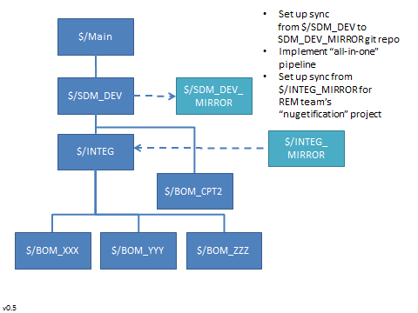
Mirroring Branches

Slide 12
The intention is that each git repository contains the code for a single BOMi artifact, broadly corresponding to a single C# or VB project, with supporting tests.

Slide 13
NuGet
NuGet is the package manager for Microsoft development platform including .NET.
NuGet provides the tools to produce and consume packages.
Each artifact that has been moved out to its own repository on TFS will be built and versioned and packaged as a NuGet package.
Each NuGet package will exist on our NuGet server. It can be downloaded when needed by a developer.

Slide 14
The Objective
The goal is to steadily factor out the existing codebase from INTEG_MIRROR\Trunk which is located in its own git repository on TFS into BOMi “artifact” repositories.
This is an “eat the elephant” type of undertaking, not something that can be done over night.
Each artifact will have its own CI pipeline to automatically build/test/package the artifact, this will be done using Jenkins automation server.

Slide 15

Questions?

